Slide 1
Introduction to Principles of Persuasion (COM 318)
Reminder: No technology is permitted in the classroom. (Please refer to the syllabus for more information.) If you violate this policy, you will lose 5% of your final grade!

Slide 2

Introduction to Persuasion
Why should you care about learning about persuasion?
The study of persuasion is one of the oldest academic disciplines.
The ancient Greeks studied rhetoric and considered it essential to a good democracy.

Slide 3
Today’s class (and next class, too!)
Definitions
How knowledge of persuasion will benefit you
Differences between persuasion, compliance-gaining, manipulation, and propaganda
Typology of compliance-gaining strategies and when to use them
The qualities that persuaders can draw power from when trying to persuade others

Slide 4
What is Persuasion?
Successful attempt to influence
Presence of some goal
The intent to reach that goal
Freedom on the part of the receiver to be influenced or not
Effects are achieved through communication
Involves some change in the mental state of the receiver (in other words, their attitude).

Slide 5
Definition of persuasion
A successful, intentional effort at influencing another person’s mental state through communication in circumstances in which the receiver has some measure of freedom.
When we try to persuade someone, we can target our efforts at changing their beliefs, opinions, or values.

Slide 6
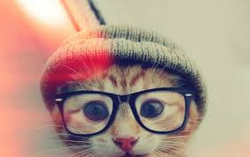
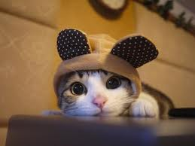
Important terms: Beliefs, opinions, values
Beliefs: our ideas about what exists factually.
  There are more cats than dogs in the U.S.
Opinions: how we feel about those facts.
  People are crazy for loving cats so much.
Values: our enduring notions of right and wrong.
  It is wrong to “own” an animal, even cats.

Slide 7
Question
What percentage of people have to use persuasion in their jobs?
How do they use it?
To get the job (during the interview process)
To get promoted
To get clients/customers
To be liked and to get help when needed
To influence others to adopt certain views

Slide 8
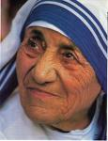
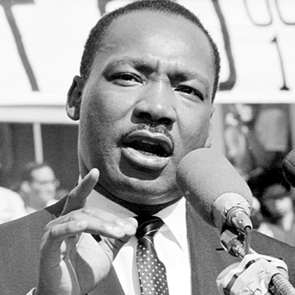
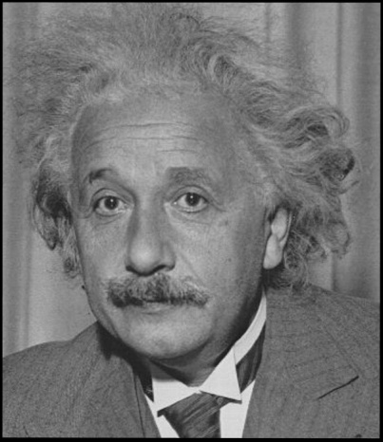
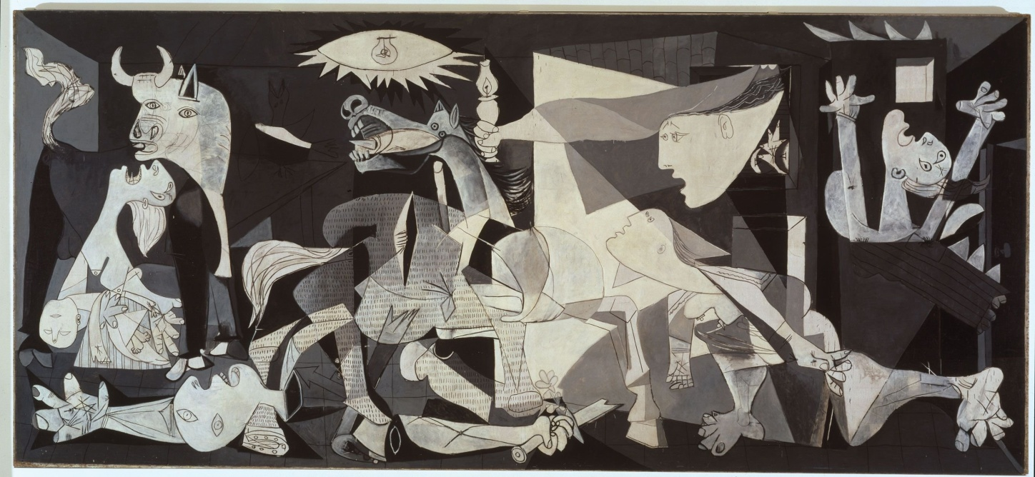
Who has to persuade? Why not just “inform” people?
Is what is “right” or “good” always self-evident? Everyone, including Mother Teresa Nobel Prize Winning Scientists, artists, and writers use persuasion to get their ideas accepted.

Slide 9
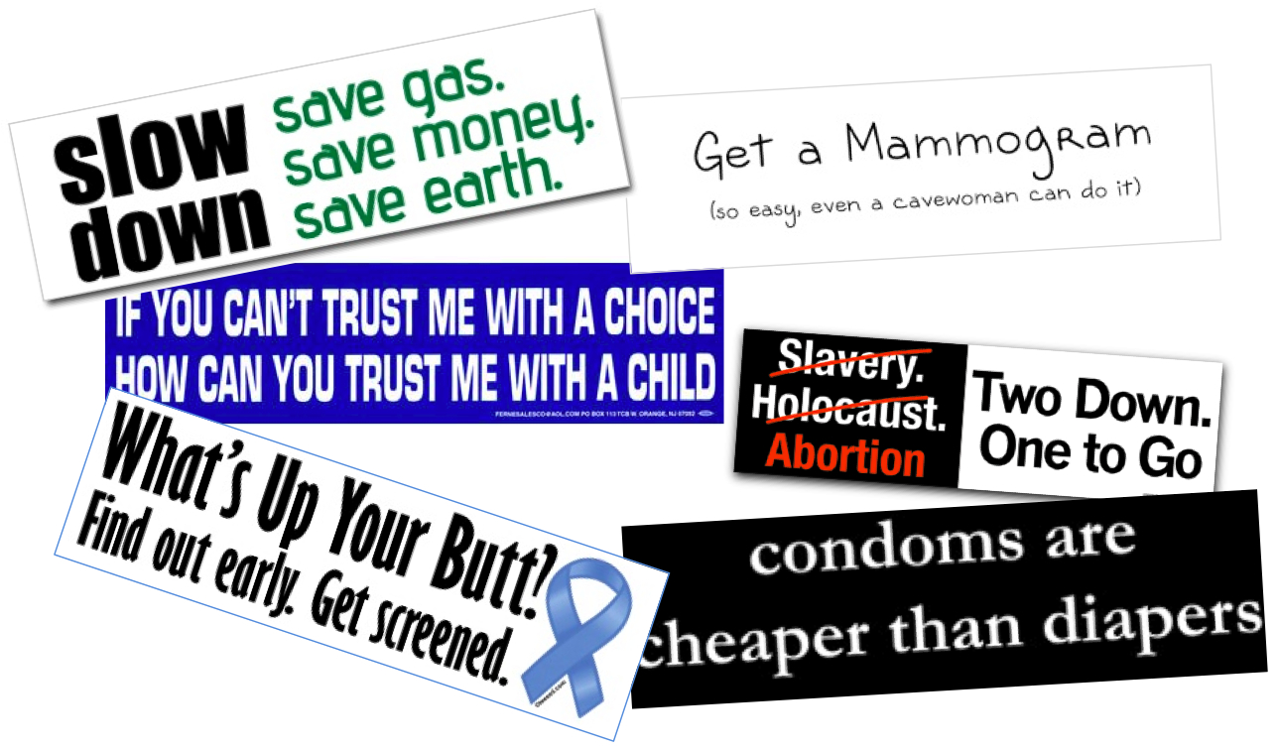
Another common attempt to persuade…

Slide 10
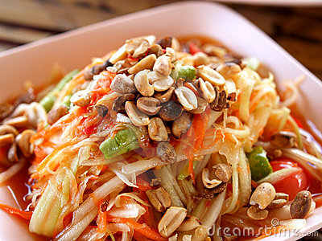
Some ways I use persuasion
Grant proposals to fund my research.
Encouraging you to study.
Telling my dad he should take his medicine.
Getting Tyler to go for Thai food when we’re in Chicago.

Slide 11
Why should YOU want to learn more about persuasion?
Instrumental function: You can get things done.
Knowledge and awareness function: When you understand persuasion, you can tailor your strategies to the situation AND make sure that what you’re doing is ethical.
Defensive function: You are better able to defend yourself against persuasion.
Debunking function: You’ll know the difference between what works and what the general public THINKS works but doesn’t.

Slide 12
What’s the difference between persuasion and manipulation?
Ethics are compromised when deception is involved or when information is concealed.
Receivers should have access to all the information they might consider important to make a good decision.
Deception removes some aspects of the receiver’s free will.
http://www.youtube.com/watch?v=REa2DDzChGM&feature=related
One can be good at persuasion without being manipulative.
(Clips: *Pharma #1, #2 & #3)

Slide 13
Reminder: No technology is permitted in the classroom. (Please refer to the syllabus for more information.) If you violate this policy, you will lose 5% of your final grade!

Slide 14
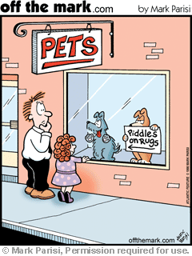
Difference between Compliance Gaining and Persuasion
Persuasion
  Change in attitudes, beliefs, values, and/or behaviors
  Umbrella term
Compliance gaining
  Focused on changing behavior.
  Getting someone to do what you want
Manipulation
  Getting someone to do (or believe) as you wish through deception

Slide 15
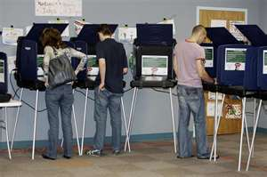

Voting: Persuasion, Compliance Gaining, Manipulation
Persuasion: Voting is easy & fun! Come vote with me!
Compliance gaining: I’m coming over tomorrow to drive you to the polls. Be ready at 9.
Manipulation: They’ll have cookies in the voting booth and martinis on the way out!

Slide 16
Where does propaganda fit in?
What distinguishes propaganda from other forms of persuasion?
  Strong ideological bent.
  Institutional in nature (organizations, government, corporations)
  Uses mass media to persuade.
  Ethically suspect methods of influence (ends justify the means)
  (Clip: *Sludge #3)

Slide 17

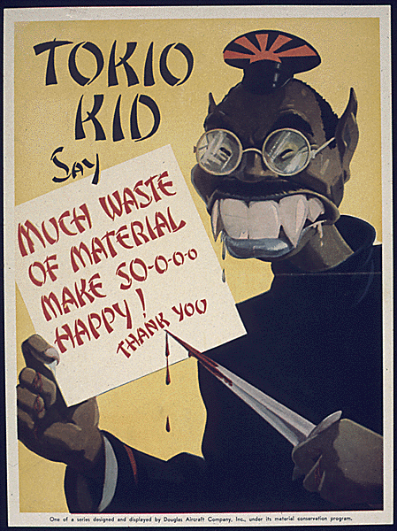

Propaganda
http://www.youtube.com/watch?v=gJ69X1qt4sQ&eurl=http%3A%2F%2Flistverse%2Ecom%2F2007%2F07%2F30%2Ftop%2D10%2Dpropaganda%2Dvideos%2F&feature=player_embedded (income tax cartoon)
http://listverse.com/2007/07/30/top-10-propaganda-videos/ (Choose a couple & watch!)

Slide 18
Seven Basic Appeals in Propaganda
Plain folks appeal (“I’m one of you”)
Testimonials
Bandwagon effect (everybody’s doing it)
Card-stacking (telling only one side of the story)
Transfer of positive or negative associations
Glittering generalities (idealistic language, patriotism)
Name-calling (racist, tree-hugger, etc.)

Slide 19
Ways we gain compliance
There are many ways we can try to gain compliance.
Marwell & Schmitt did a large study in the 1960s and identified 16 common ways that people try to get other people to do what they want.

Slide 20
Marwell & Schmidt’ s Typology of Compliance-Gaining Strategies
Promise
Threat
Expertise (positive/negative outcomes)
Liking
Pre-giving
Aversive Stimulation
Debt
Moral appeal
Self-feeling (positive/negative)
Altercasting (postive/negative)
Altruism
Esteem (positive/negative)

Slide 21
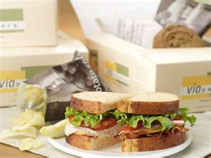
Promise
I will take you out to lunch tomorrow if you go vote.

Slide 22
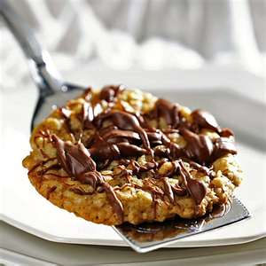
Threat
I will never make you cookies again if you don’t vote. (I will also taunt you with every bad decision the elected leader makes if the wrong person wins.)

Slide 23

Expertise
I know from experience that if you don’t vote, the wrong person will win by one vote.

Slide 24
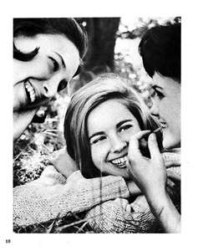
Liking
Gosh, you’re so awesome. I’m glad we’re friends. You’re one of the smartest people I know. So, who are you going to vote for tomorrow?

Slide 25
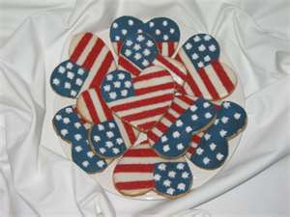
Pre-giving
Look at these scrumptious cookies I baked for you. Ready to go vote with me tomorrow?

Slide 26
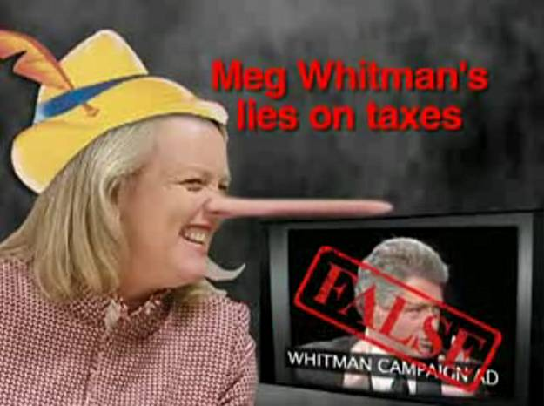
Aversive Stimuli
We will watch political ads on television and YouTube until you agree to vote.

Slide 27
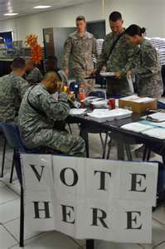
Debt
Many people who have died in wars to protect our democracy. You owe it to them to vote.

Slide 28

Moral Appeal
It is your duty as an American to vote.

Slide 29
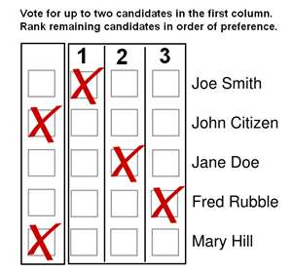
Self-feeling (positive/negative)
Just think of how great you’re going to feel if the right person wins the election.
Just think of how lousy you’re going to feel if the wrong person wins the election.

Slide 30
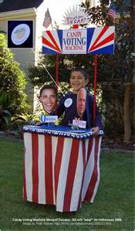
Altercasting (positive/negative)
A good person would vote.
Only a bad person wouldn’t vote.

Slide 31

Altruism
Vote for the sake of future generations!

Slide 32

Esteem (positive/negative)
Democracy matters to me, so I will think more of you if you do vote.
Democracy matters to me, so I will think worse of you if you don’t vote.

Slide 33
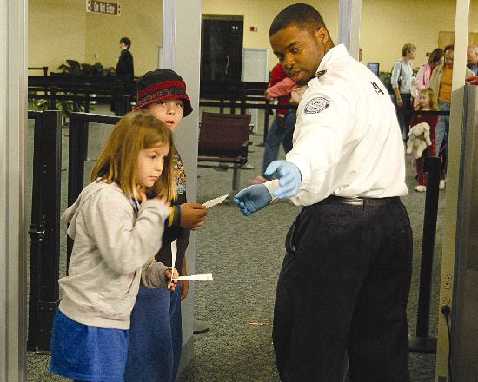
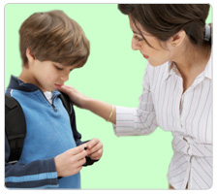
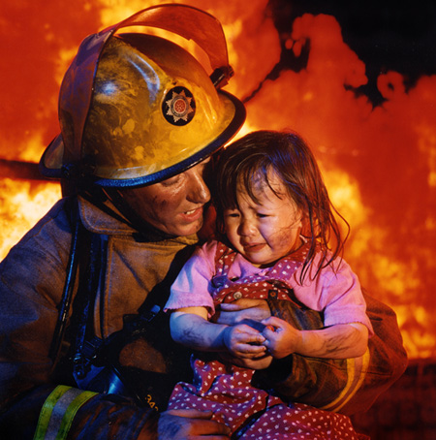
Compliance Gaining Strategy Choice Depends on Assessments of:
Importance of getting compliance.
  When is it important to get compliance?

Slide 34
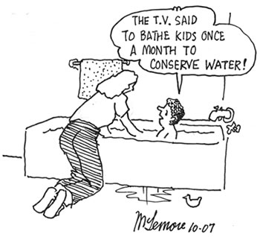
Choice of Compliance-Gaining Strategy, continued:
How successful we think the strategy will be.
  We adapt our strategy to the person who is our target and we use what we think will work best with them.

Slide 35
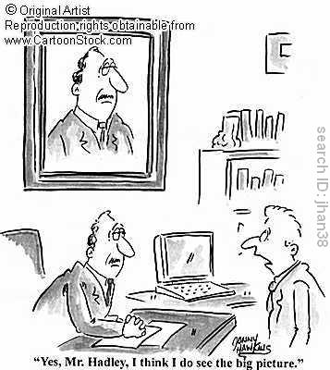
Choice of Compliance-Gaining Strategy, continued:
Dominance: Power and control
  If we have more reward, coercive, and legitimate power, we have a wider range of strategies at our disposal.

Slide 36
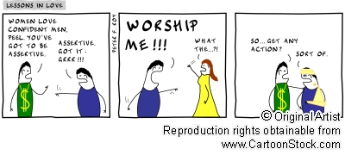
Choice of Compliance-Gaining Strategy, continued:
Intimacy: Degree of emotional attachment
  Impersonal/short-term relationships vs. Interpersonal/long-term relationships

Slide 37
Choice of Compliance-Gaining Strategy, continued:
Relational consequences: Long vs. short term
  We’re unlikely to want to create long-term damage to a relationship we want to preserve

Slide 38
Choice of Compliance-Gaining Strategy, continued:
Resistance: Whether we think the other person will defy us
  How do we overcome resistance to compliance gaining attempts?

Slide 39
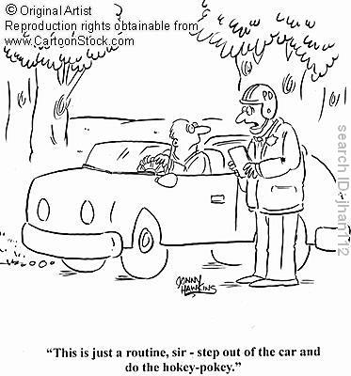
Choice of Compliance-Gaining Strategy, continued:
Rights: The belief that our request is justified
  Corresponds to legitimate power

Slide 40
Choice of Compliance-Gaining Strategy, continued:
Personal benefits: An assessment of what we think will benefit either/both of us the most
  Why would we engage in compliance gaining if it benefits someone other than ourselves?

Slide 41
Choice of Compliance-Gaining Strategy, continued:
Apprehension: Nerves may keep us from acting the way we would like to
  What situations would create apprehension when we’re trying to gain compliance?

Slide 42
Another way to look at it…
Some researchers argue that most of our decisions about how to pursue a compliance-gaining goal boil down to two primary dimensions:
  Efficiency: What will work the best?
  Appropriateness: What is socially acceptable?

Slide 43
Secondary dimensions…
Other considerations we take into account (secondary dimensions):
  Identity goals: our moral standards for who we want to be
  Interaction goals: creating and maintaining a good impression
  Resource goals: maintaining important relationships and increasing personal rewards
  Arousal goals: wanting not to get too nervous, overwhelmed, or stressed out– either by going through with the influence attempt or by not doing anything about getting what we want

Slide 44
Does our choice of strategy depend on how well we know the other person?
Yes.
People prefer to use friendly strategies in general.
We are more likely to use threats with strangers we don’t have to see again.
We use a wider variety of strategies with strangers than intimates (trial and error).

Slide 45
Bases of Power: French & Raven 1960
Reward power
Coercive power
Legitimate power
Expert power
Referent power

Slide 46
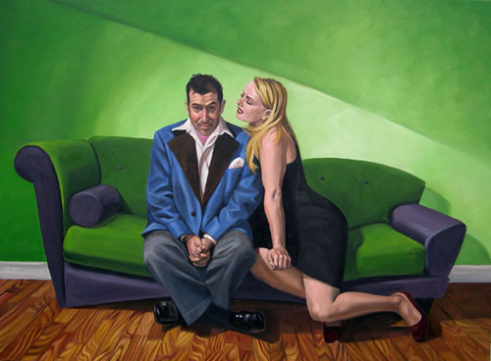
Reward Power
The power to reward someone if they do what you want.

Slide 47
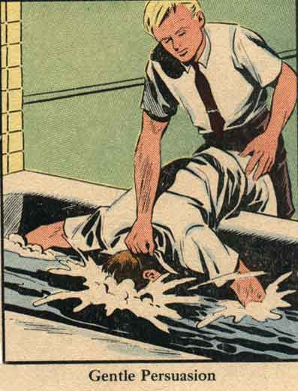
Coercive Power
The power to punish someone if they do not comply with your request

Slide 48
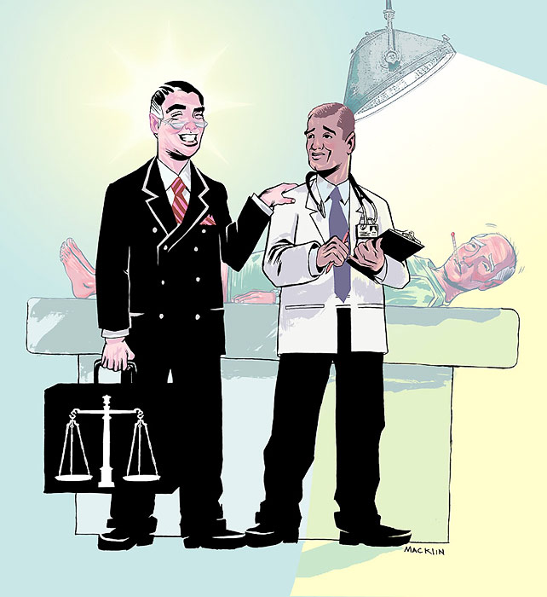
Expert Power
The power granted to a person by virtue of their education (PhD, MD) or their (generally relevant) experiences with a subject.

Slide 49
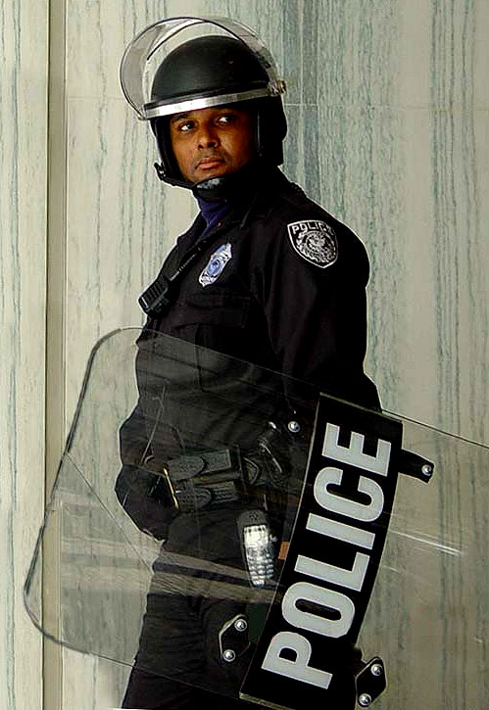
Legitimate Power
Power that is granted to you by virtue of your position (being “the boss”).
This is power that is conferred by society; we tend to agree as a culture that certain people should have sway over our behaviors.

Slide 50
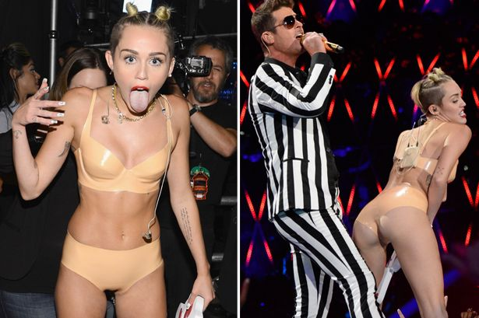

Referent Power
The power that is granted to someone by others because they are well-liked or admired.
Movie stars and celebrities have this power, but so do ordinary people who are very popular.

